Slide 1
Cryptographic Hash
Hash
“Cryptography and Network Security” by W. Stallings
Notes:
Lecture slides by Lawrie Brown for “Cryptography and Network Security”, 4/e, by William Stallings, Chapter 11 – “Message Authentication and Hash Functions”.
Demo : Openssl + Java program in slide ___

Slide 2
Content
Different requirements of message security
Hash Algorithm construction
Overview of the SHA-2 core hash function
Attacks
The requirements of hash function in different applications.

Slide 3
Security ≠ Encryption
Possible attacks
disclosure
traffic analysis
masquerade
content modification
sequence modification
timing modification
source repudiation
destination repudiation
message confidentiality
message authentication
Notes:
Security is NOT == encryption, what’s app having end to end encryption. Is what’s app secure?
Authentication is needed which can be better served by other tools
Will Discuss HASH and MAC in this lesson, how it is being used

Slide 4
Requirements of message security
Message confidentiality
Adversary cannot understand (decrypt) the message
Message authentication is concerned with:
Integrity of a message
Has the message changed / modified in transit?
Validating identity of the originator
Ascertain the sender of the message
Non-repudiation of origin (dispute resolution)
Recipient passes the message + proof to 3rd party, The 3rd party will be confident that the message originated from the sender

Slide 5
Encryption
Strong encryption provides confidentiality.
Provides some authentication
Using symmetric key (1 key) encryption
Receiver assumed sender must have created the message
since only the sender and receiver know the key
Receiver assumed message content cannot have been altered
Encrypted - Altering message → corrupted message
If message has suitable structure such as redundancy or checksum
Notes:
Message encryption by itself can provide a measure of authentication. Here, the ciphertext of the entire message serves as its authenticator, on the basis that only those who know the appropriate keys could have validly encrypted the message. This is provided you can recognize a valid message (ie if the message has suitable structure such as redundancy or a checksum to detect any changes).

Slide 6
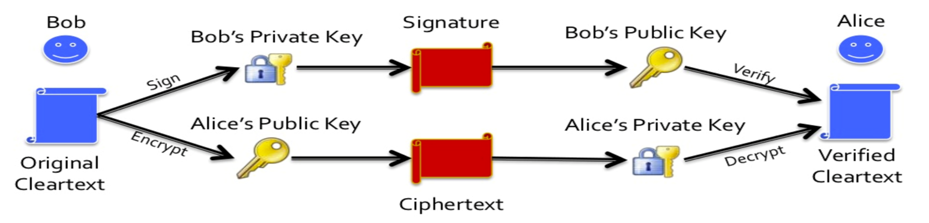
Encryption
Image Source : https://www.slideshare.net/easel1/django-cryptography/16-Asymmetric_Nway_encrypt_decrypt_sign Slide 16
Using public-key encryption :
Encryption provides no information of sender
In public key system, sender can signs message using their private-key then encrypts with recipient’s public key
Provide both secrecy and authentication
Note: 2 pairs of public-private keys used
Notes:
With public-key techniques, can get a digital signature which can only have been created by key owner. But at cost of two public-key operations at each end on message.

Slide 7

Tools for message authentication
Hash
Message Authentication Code (MAC)
Digital Signature

Slide 8
Hash Algorithms Requirements
Description | Desired features
Input (data / message) Length | Variable Size
Output (digest) Length | Fixed Size
Encryption Key | ✖ Not required
Speed of Processing (may be a chokepoint of the process, network speed is often the chokepoint for data communication) | As fast as possible
One-way function (it is irreversible) | ✔ (irreversible)
Collision resistant (No 2 identical digests if the message are different | ✔
Pseudo-randomness (digests from similar message must be very different) | ✔
Notes:
Special Attention Required

Slide 9
Hash
Ref : Cryptography and network Seurity, 7e, Stallings

Slide 10
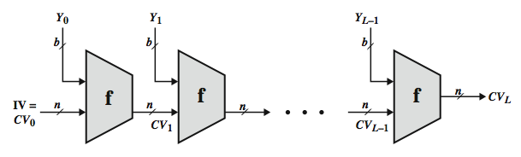
Merkle-Damgård Construction
Sort of like a Chained Block Cipher
Append padding and length to message
Break input into equal-sized blocks (1024 or 512 bits)
Apply compression function f iteratively
Saves state from one iteration to next
Hash is as strong as compression function
Notes:
10
As with encryption algorithms, cryptanalytic attacks on hash functions seek to exploit some property of the algorithm to perform some attack other than an exhaustive search. In recent years, have much effort, and some successes, in developing cryptanalytic attacks on hash functions. Must consider the overall structure of a typical secure hash function, referred to as an iterated hash function, as indicated in Stallings Figure 11.7. This was proposed by Merkle and is the structure of most hash functions in use today. The hash function takes an input message and partitions it into L fixed-sized blocks of b bits each. If necessary, the final block is padded to b bits. The final block also includes the value of the total length of the input to the hash function. The inclusion of the length makes the job of the opponent more difficult. The hash algorithm involves repeated use of a compression function, f, that takes two inputs (an n-bit input from the previous step, called the chaining variable, and a b-bit block) and produces an n-bit output. At the start of hashing, the chaining variable has an initial value that is specified as part of the algorithm. The final value of the chaining variable is the hash value. Often, b > n; hence the term compression. The motivation for this iterative structure stems from the observation by Merkle and Damgard that if the compression function is collision resistant, then so is the resultant iterated hash function. Therefore, the structure can be used to produce a secure hash function to operate on a message of any length. Cryptanalysis of hash functions focuses on the internal structure of f and is based on attempts to find efficient techniques for producing collisions for a single execution of f. Once that is done, the attack must take into account the fixed value of IV. The attack on f depends on exploiting its internal structure. The attacks that have been mounted on hash functions are rather complex and beyond our scope here.
10

Slide 11
Hash Algorithms - Construction
Merkle-Damgard construction (for handling big variable input message) is proven collision resistant if the Hash Function (F) is collision resistant
Hashing algorithm (i.e. MD5, SHA1, SHA2) uses a different hash function but based on the same Merkle-Damgard construction concept
http://slideplayer.com/slide/9400105/
Notes:
Video for proving Merle-Damgard paradigm is collusion resistant - https://www.youtube.com/watch?v=sawkPgsQPwg

Slide 12
Known Hash Algorithms
MD4 and MD5 by Ron Rivest (1990,1994)
SHA-0, SHA-1 by NSA (1993, 1995)
SHA-2
2002 – Hash digest : 224, 256, 384, 512 bits
SHA-3
Whirlpool (Not washing machine!!!)
Tiger
Others…

Slide 13
Simple Hash Functions
Based on XOR of message blocks (+ rotate bits)
Insecure → Predictable effect on digest (by manipulating message ) → Non Collision resistant
If message itself is not encrypted, it is easy to modify the message and append one block that would set the hash code as needed!!
Notes:
Despite the 2 messages are different → Same hash
In this case using XOR as the basis of hash function
Note the extra message blocks can “cancel” the effect of the hash.

Slide 14
Secure Hash Algorithm (SHA)
SHA was originally designed by NIST & NSA in 1993, revised in 1995 as SHA-1
US standard for use with DSA signature scheme
standard is FIPS 180-1 1995, also Internet RFC3174
Note: algorithm = SHA, the standard = SHS
Based on design of hash function MD4 with key differences
produces 160-bit hash values
In 2005 SHA-1 have raised concerns on its use in future applications
Note : FIPS (FEDERAL INFORMATION PROCESSING STANDARDS)
Notes:
The Secure Hash Algorithm (SHA) was developed by the National Institute of Standards and Technology (NIST) and published as a federal information processing standard (FIPS 180) in 1993; a revised version was issued as FIPS 180-1 in 1995 and is generally referred to as SHA-1. The actual standards document is entitled Secure Hash Standard. SHA is based on the hash function MD4 and its design closely models MD4. SHA-1 produces a hash value of 160 bits. In 2005, a research team described an attack in which two separate messages could be found that deliver the same SHA-1 hash using 2^69 operations, far fewer than the 2^80 operations previously thought needed to find a collision with an SHA-1 hash [WANG05]. This result should hasten the transition to newer, longer versions of SHA.

Slide 15
Revised Secure Hash Standard (SHA-2)
NIST issued revision FIPS 180-2 in 2002, FIPS PUB 180-4 in 2012
Total have six verisons of SHA2
SHA-224, SHA-256, SHA-384, SHA-512,
SHA-512/224, SHA-512/256.(added in FIPS PUB 180-4)
with digests (hash values) that are 224, 256, 384 or 512 bits
designed for compatibility + increased security
Structure & detail are similar to SHA-1
Analysis should be similar
Much higher security
Notes:
In 2002, NIST produced a revised version of the standard, FIPS 180-2, that defined three new versions of SHA, with hash value lengths of 256, 384, and 512 bits, known as SHA-256, SHA-384, and SHA-512. These new versions have the same underlying structure and use the same types of modular arithmetic and logical binary operations as SHA-1, hence analyses should be similar. In 2005, NIST announced the intention to phase out approval of SHA-1 and move to a reliance on the other SHA versions by 2010. See Stallings Table12.1 for comparative details of these algorithms.

Slide 16
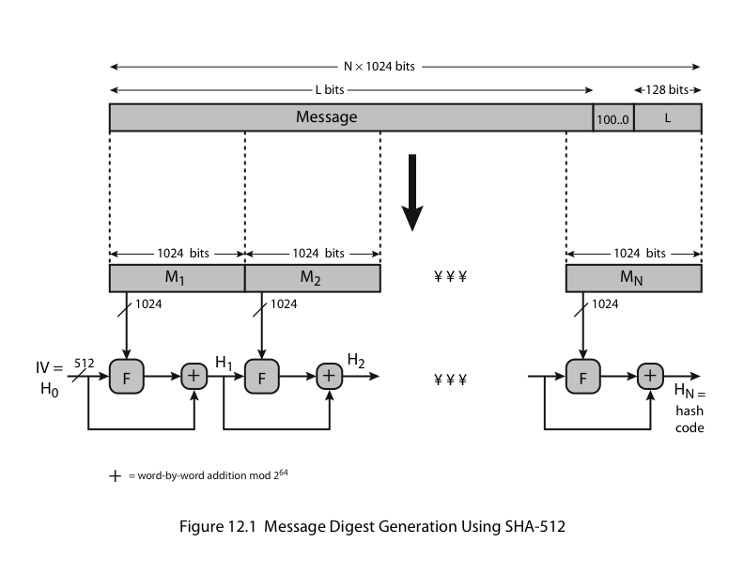
SHA-512 Overview
Uses the Merkle-Damgard construction with the F compression function

Slide 17
Processing of SHA-512
Step 1: Append padding bits
Step 2: Append length of the message
Step 3: Initialize hash buffers (words)
Step 4: Process the message in 1024-bit blocks, (The F function in the overview)
Step 5: Output the final state value as the resulting hash
For detailed algorithm:-
http://www.herongyang.com/Cryptography/SHA1-Message-Digest-Algorithm-Overview.html
Notes:
Special Attention Required
Similar for other versions – Different in length
Details in Chapter 11 of textbook p344
Or see the link http://www.herongyang.com/Cryptography/SHA1-Message-Digest-Algorithm-Overview.html

Slide 18
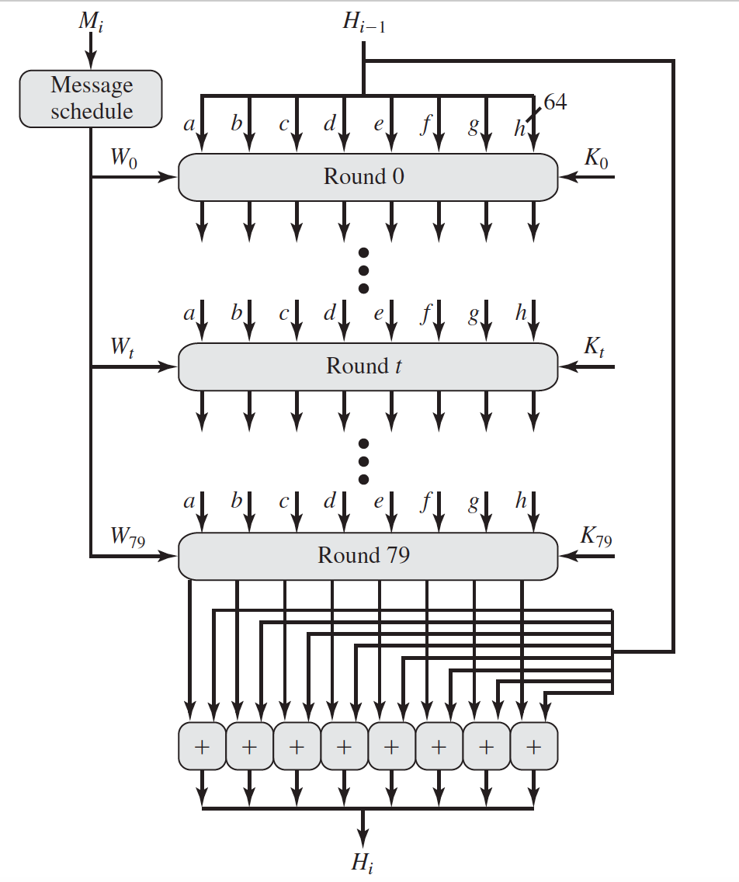
Processing of SHA-512
Notes:
- Registers to hold the values (state) between the rounds
- The round function is applied 80 times (0-79)
The initial values is added to the digest on the LAST round
The H₀ – H_{L} (512 bits), The initial H₀ uses IV (constants)
Note the 2 input M (message schedule) & K (Constants)

Slide 19
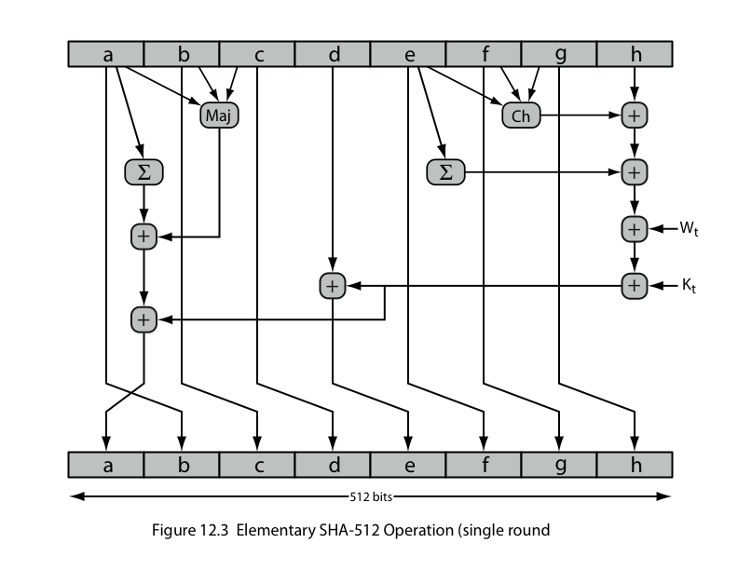
SHA-512 Round Function
Each round of compression function has sub-functions. i.e
Maj(a,b,c)
The K₀-K₇₉ are 64-bit additive constants
Notes:
Note
The message ( 1024 bits) is feed as W₀₋₇₉ (See 2 slides down)
The K₀-K₇₉ are 64-bit additive constants
Other functions
Ch(e,f,g) = (e AND f) XOR (NOT e AND g) choose: e => f, !e => g
Maj(a,b,c) = (a AND b) XOR (a AND c) XOR (b AND c) majority:
∑(a) = ROTR(a,28) XOR ROTR(a,34) XOR ROTR(a,39) sum:
∑(e) = ROTR(e,14) XOR ROTR(e,18) XOR ROTR(e,41) sum:
+ = addition modulo 2^64

Slide 20
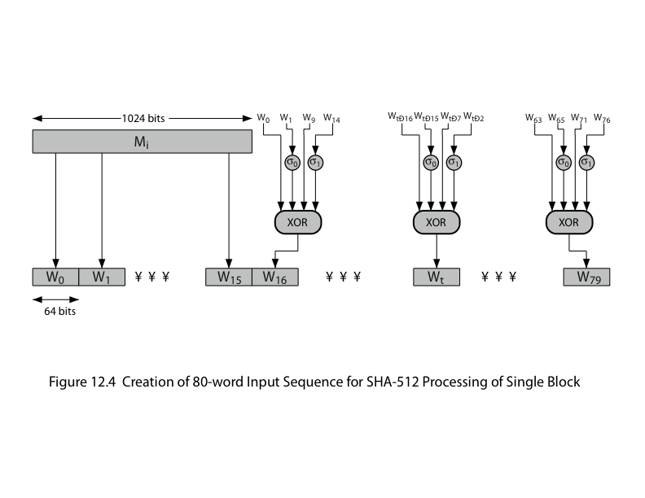
SHA-512 Message Expansion
The 1024 bit message is fed multiples times into the F function as (W)
W₀₋₁₅ - Original message (64 bit / word)
W₁₆₋₇₉ - Circular left shift by one bit of the XOR of four of the preceding values of W_{t} , with two of those values subjected to shift and rotate operations
Notes:
∂0(x) = ROTR(x,1) XOR ROTR(x,8) XOR SHR(x,7)
∂1(x) = ROTR(x,19) XOR ROTR(x,61) XOR SHR(x,6).
Thus, in the first 16 steps of processing, the value of is equal to the corresponding
word in the message block. For the remaining 64 steps, the value of W_{t}
consists of the circular left shift by one bit of the XOR of four of the preceding
values of W_{t} , with two of those values subjected to shift and rotate operations.This
introduces a great deal of redundancy and interdependence into the message blocks
that are compressed, which complicates the task of finding a different message
block that maps to the same compression function output.

Slide 21
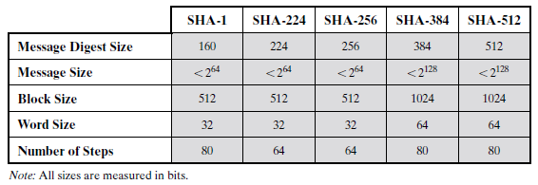
Message Size limitations
Corresponding to the number of reserved bits in the Pad Length block, different Hash functions have different maximum message size limitations:

Slide 22
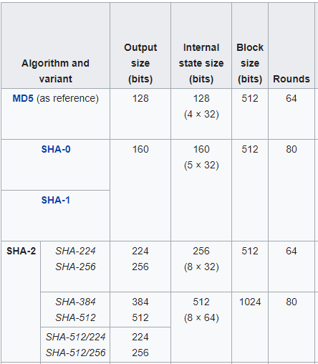
Comparison of SHA Functions
https://en.wikipedia.org

Slide 23
Attacks
Preimage Resistance
Easy to generate a code given a message, but virtually impossible to generate a message (or part of it) given a code
Given y, it is difficult to find an x such that h(x) = y
Second Preimage Resistance
Computationally infeasible to find a pair of messages with the same hash value
Given x, it is difficult to find a second preimage x′ ≠ x such that h(x) = h(x′)
Message
Hash
Message A
Hash
We are usually more concern
about second preimage attack!!
Message A1
Notes:
Weak - Find any 2
Strong - Find the desired pair

Slide 24

Attacks (Cont)
Birthday attack
General purpose attack on Hash functions
Higher likelihood of collisions found between random attack attempts and a fixed degree of permutations
Problem statement
What is the probability that any two students in a class have the same birthday when there are 23 students in a class?
50%

Slide 25
Birthday Attacks
Assumptions
Nobody born on 29 Feb
The distribution of birthday is evenly spread
If we only have 2 students in a class, the probability that these 2 students have no same birthday is 364/365 = 0.9973
If we increase one more student in the class, the probability that all 3 students have no same birthday is 0.9973 * (363/365) = 0.9918 and so on…
If we increase to 23 students in a class, the chance of every one have a unique birthday is about 0.4927. As such, chance of at least two sharing a birthday =
1 – 0.4927 = 0.5073 which is about 50%!
So, the probability that at least one student has the same birthday as any other student on any day is 1 – 365!/((365-n)!*365^{n})

Slide 26
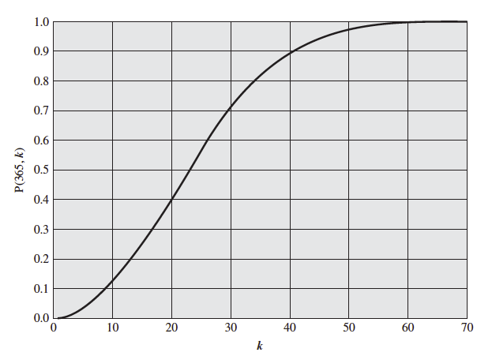
Birthday Paradox
Notes:
Hoe many students in your class can you expect a 50% chance 2 students have the same birthday - 23
60 – 70 students you are quiet sure there are at least 2 having the same birthday

Slide 27
Application of Hash algorithms
Public Key Algorithms
Password Logins
Encryption Key Management
Digital Signatures
Integrity Checking
Virus and Malware Scanning
Authentication
Secure Web Connections
(PGP, SSL, SSH, S/MIME)

Slide 28
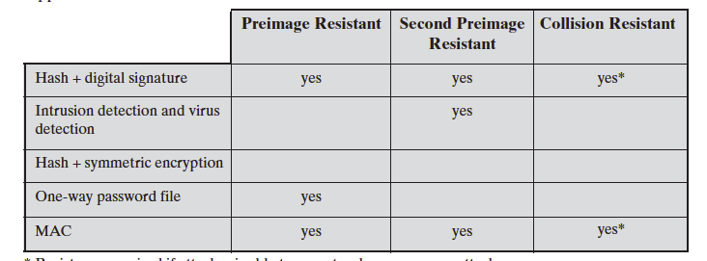
Hash Algorithms Requirements in Application
*Resistance required if attacker is able to mount a chosen message attack (CMA)
Notes:
CMA: adversary is allowed to get the signature of number of messages, of her choice, from the signer.

Slide 29
Summary
Message security involves authentication.
The Merkle-Damgard construction for hash algorithm
How SHA-2 works
Different type of attacks
Different applications have different requirements of Hash functions
Notes:
Chapter 11 summary.

